Slide 1

PREDICTING FUTURE POTENTIAL STARBUCKS LOCATIONS
University of Colorado, Denver
Anamika Singh, Rubina Shaik, Shivali Arora and Shruthi Prasad

Slide 2
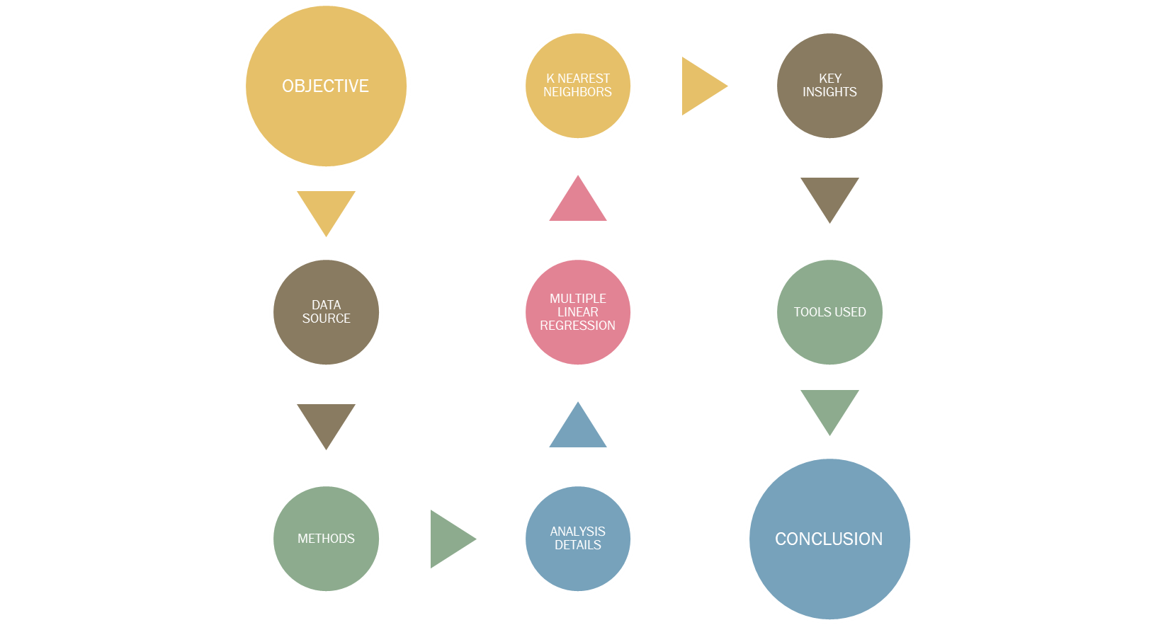
CONTENTS

Slide 3

Objective
Predicting locations in the United States where Starbucks could open future stores by analyzing present store locations data and its mapping to Census demographics

Slide 4
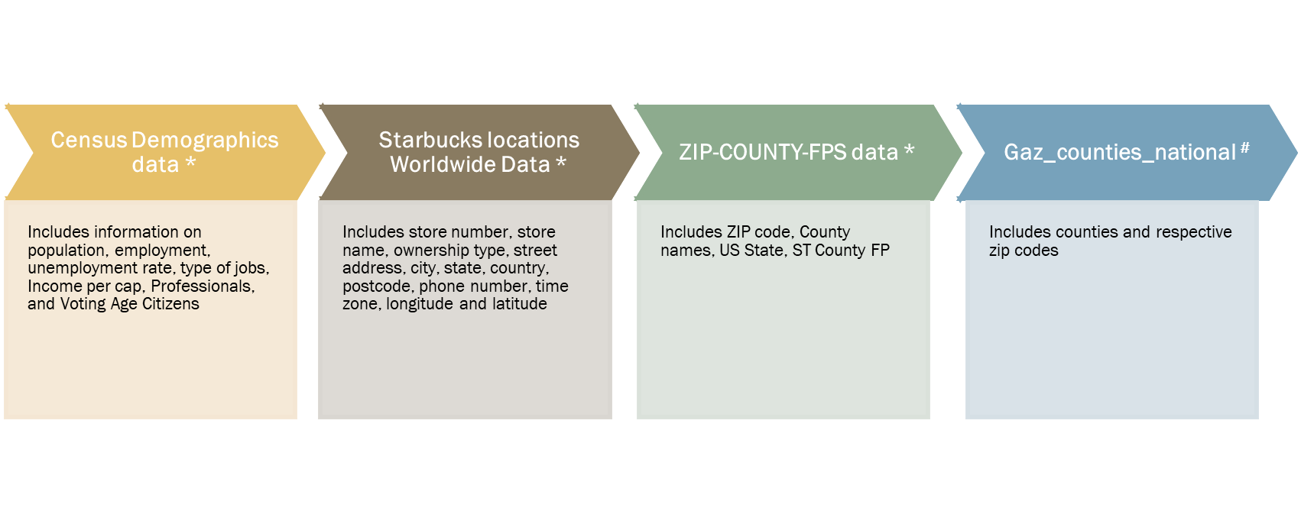
Data source(s)
Source of Datasets:
* Kaggle.com
# United States Census Bureau

Slide 5
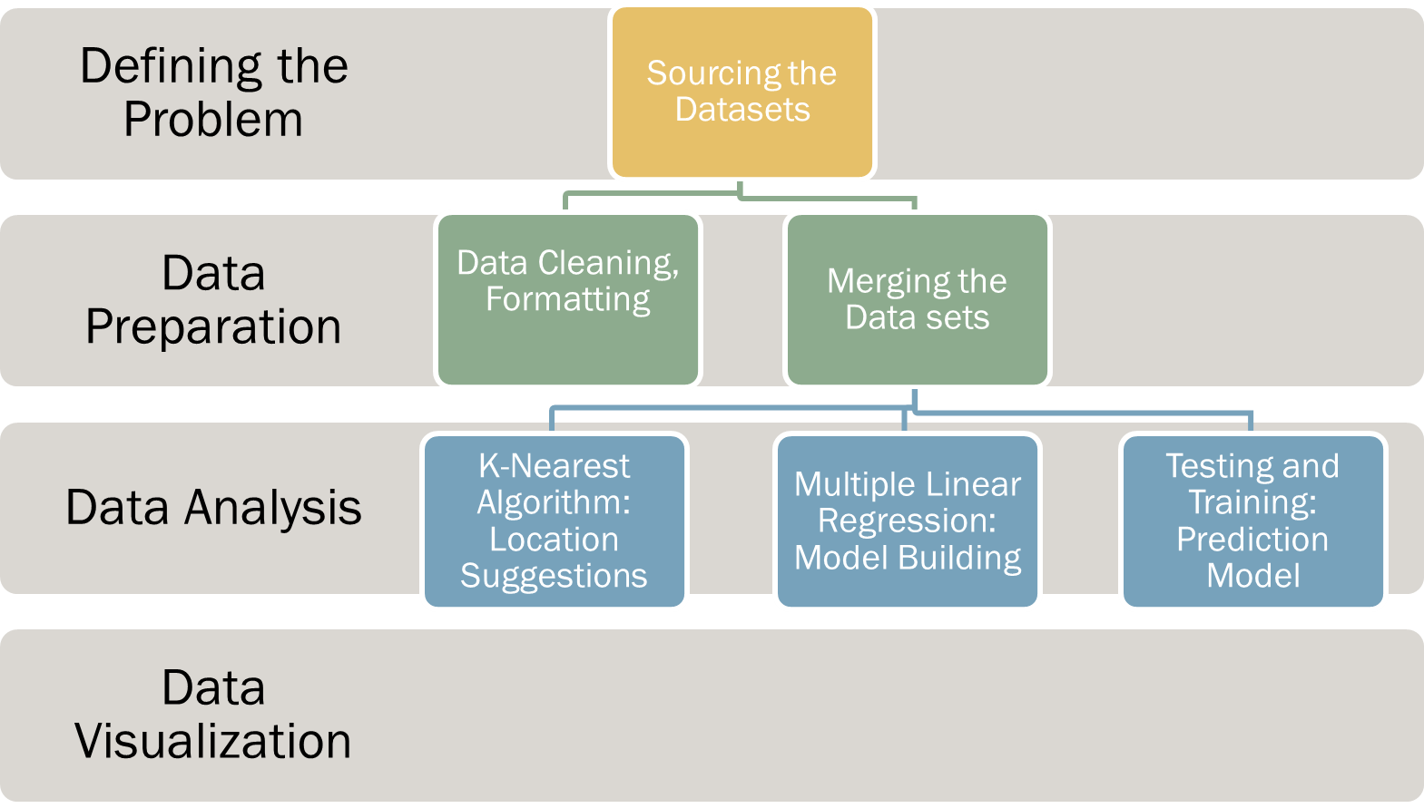
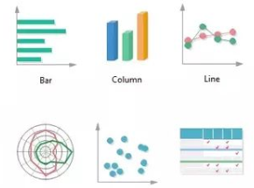
METHODS

Slide 6
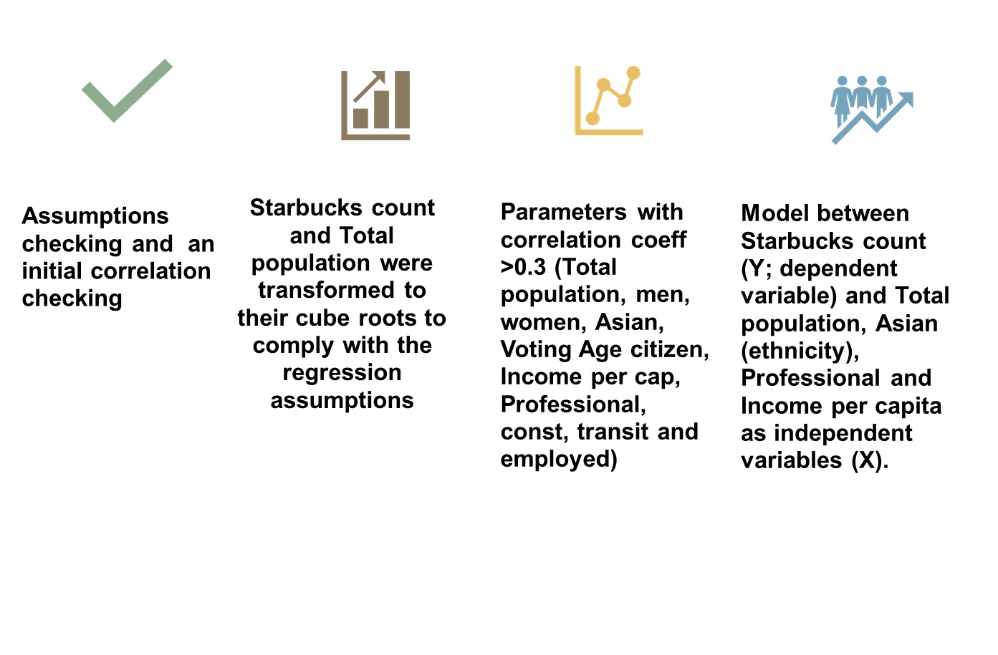
Steps in Multiple
Linear Regression

Slide 7
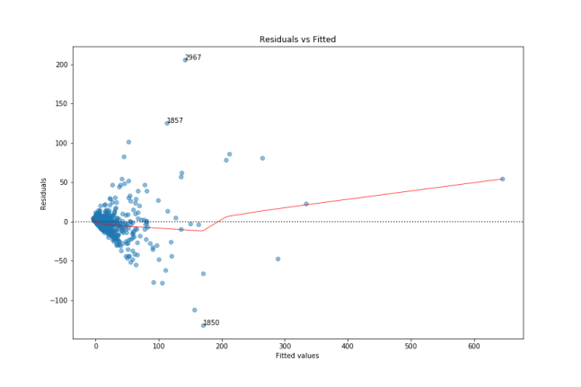
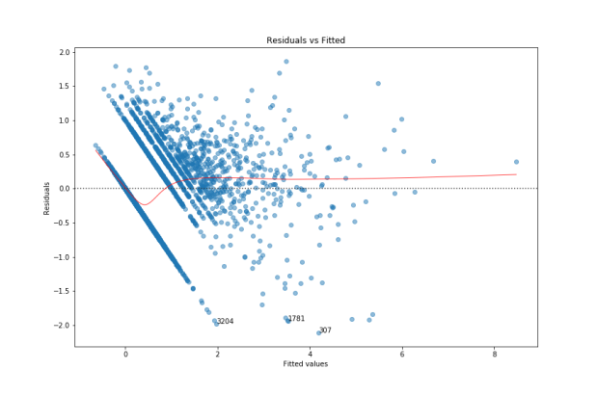
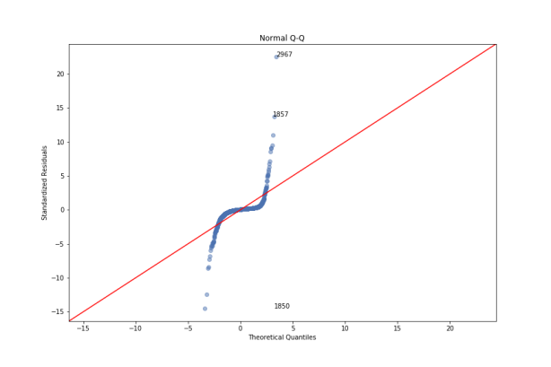
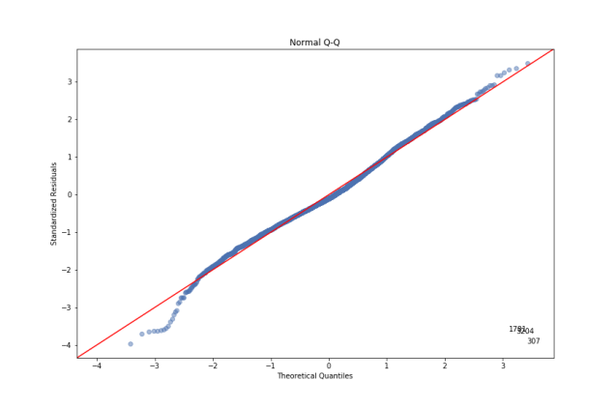
The assumptions were checked using residual and QQ plots
Residual Plots of Total Population Before and After Cubic Transformation
QQ Plot Before and After Cubic Transformation

Slide 8
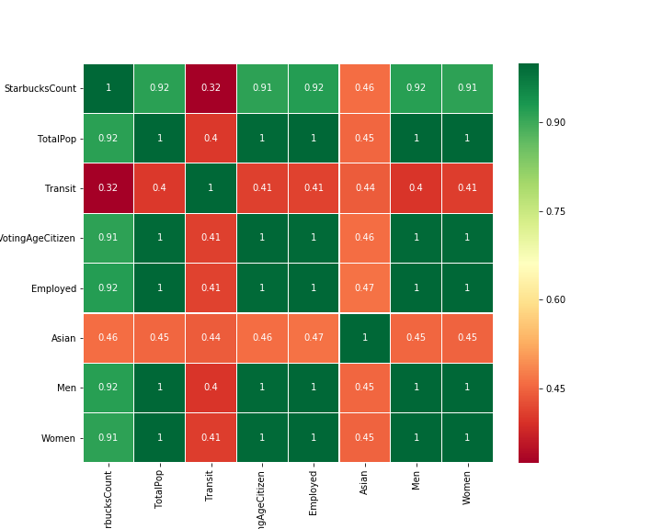
CORRELATION HEAT MAP

Slide 9
Multiple Linear Regression Equation
CubicRootStarbucksCount = (-1.5171)+ 3.93753743e-02*(CubicRootTotalPop)+ 2.27014241e-02*(Asian)+ 1.06304548e-02*(Professional) + 2.22515756e-05*(IncomePerCap)

Slide 10
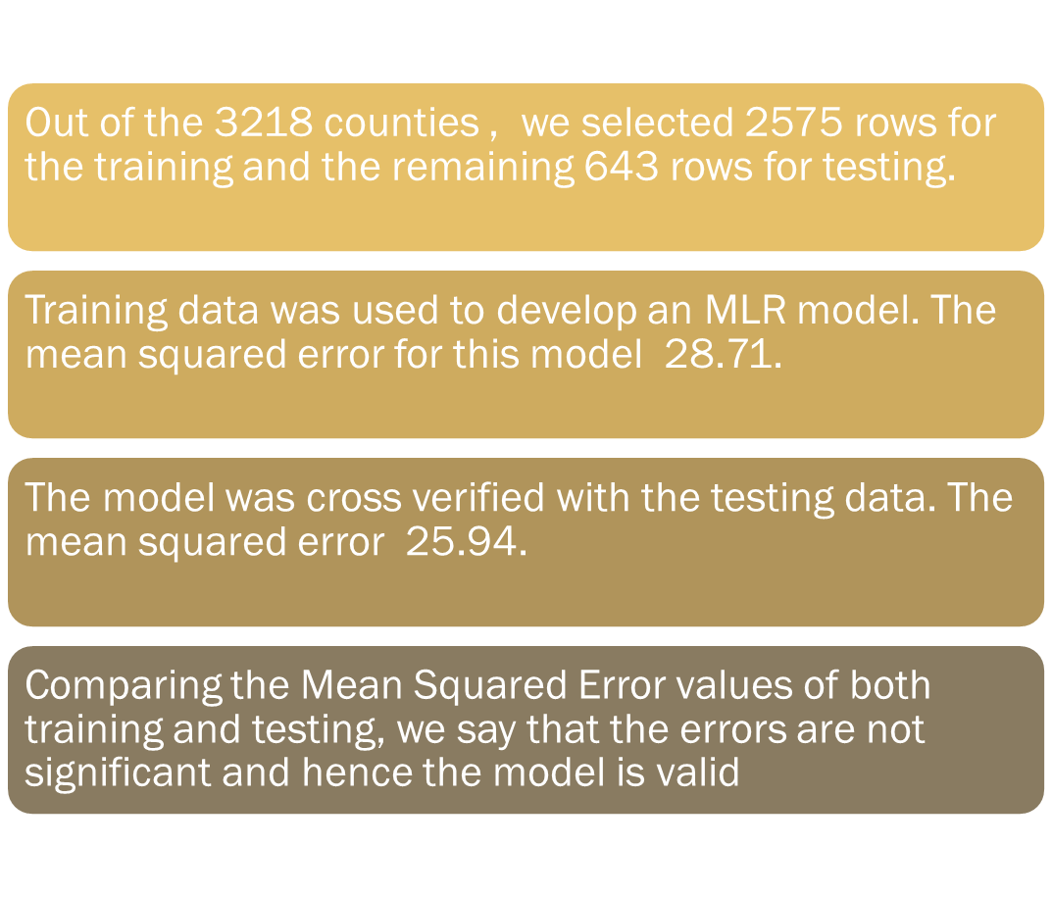
Training and Testing

Slide 11
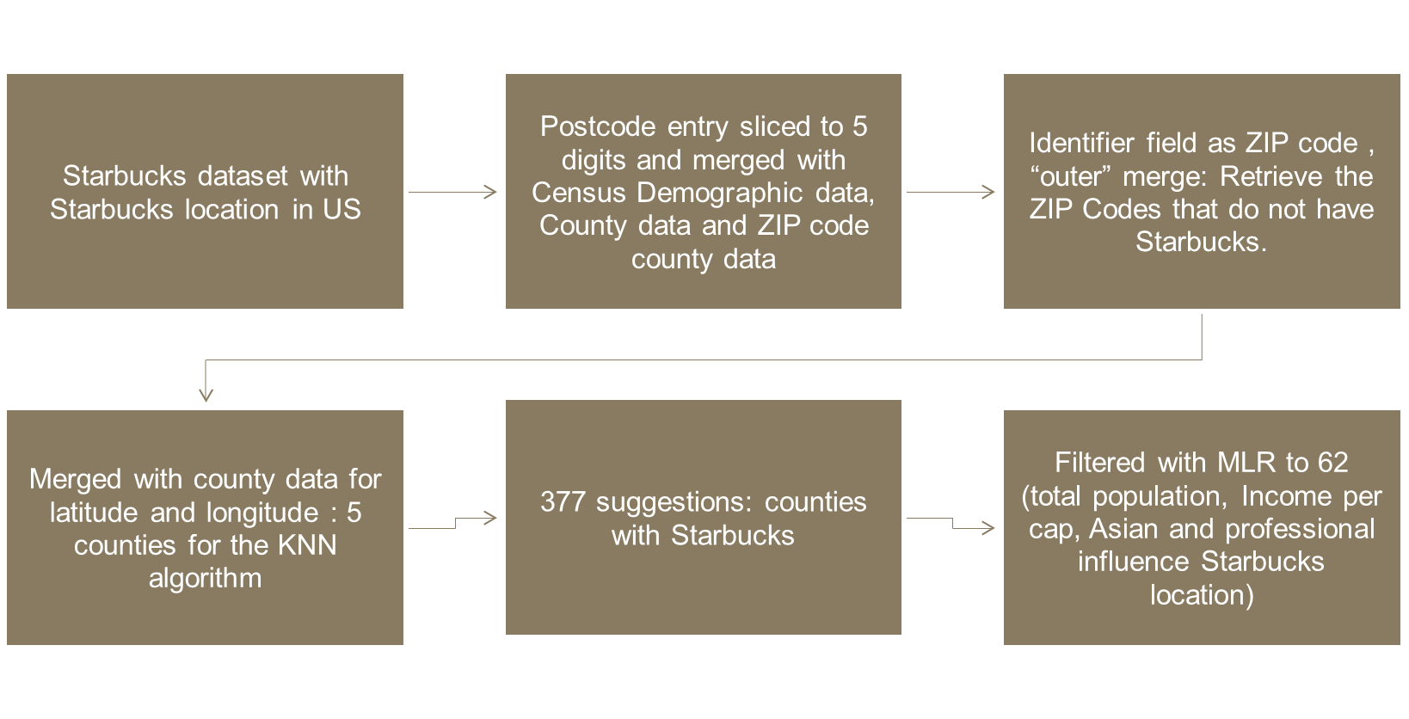
K- NEAREST NEIGHBORS

Slide 12
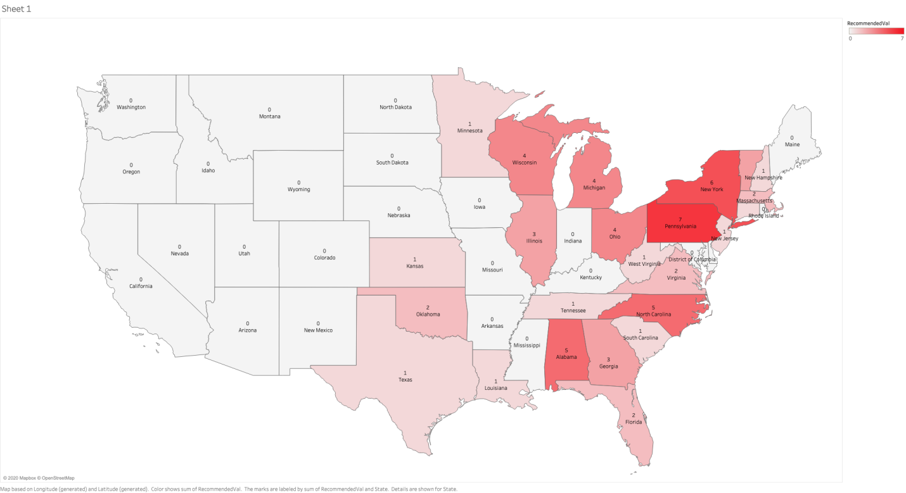
The KNN algorithm resulted in 377 suggested locations where Starbucks could potentially open a new store.
Applying MLR to KNN results yielded 62 Counties. State wise recommendations are highlighted in the heat map.
Heat map showing predicted Starbucks Store across US
Higher predictions for opening Starbucks stores in the East coast; specifically Pennsylvania, New York, Alabama and North-Carolina with highest predictions of 7, 6, 5 and 5 store openings, respectively

Slide 13
With k-nearest algorithm, we were trying to answer the question whether a county should have a Starbucks store or not. We assumed that greater than or equal to three surrounding counties with Starbucks would lead to higher brand recognition and hence higher sales.
The initial results from the KNN algorithm provided a list of counties which sometimes had lower population, income per capita, Asians and professionals.
MLR model was well fitted with an adjusted r2 of about 72.5% and mse of 25.9.
Cross verified the KNN algorithm results with MLR model and chose those counties where prediction was greater than or equal to 1; compared the predicted values against the current Starbucks count in a county
Positive difference indicated an opportunity to increase the number of Starbucks count in that county and a negative difference indicated an opportunity to reduce the footprint of Starbucks.
KEY INSIGHTS

Slide 14
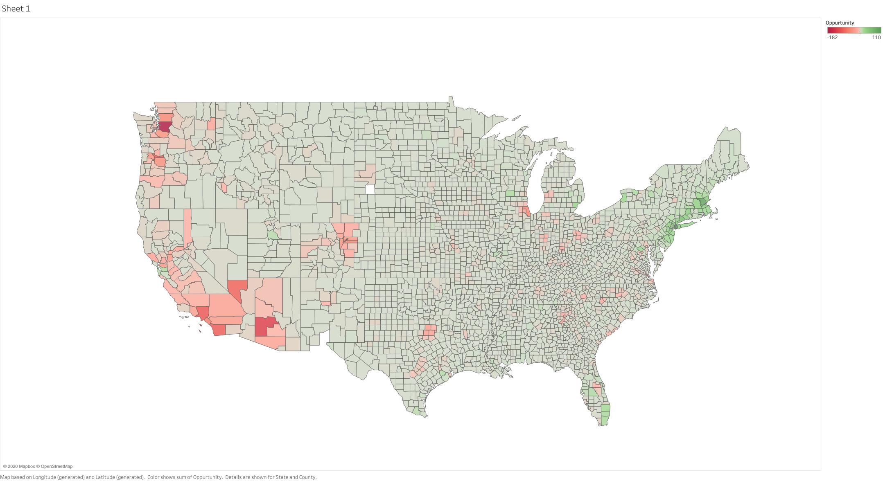
RED REGIONS HIGHLIGHT OPPORTUNITIES TO REDUCE STARBUCKS FOOTPRINT AND GREEN REGIONS HIGHLIGHT OPPORTUNITIES TO OPEN MORE STARBUCKS

Slide 15
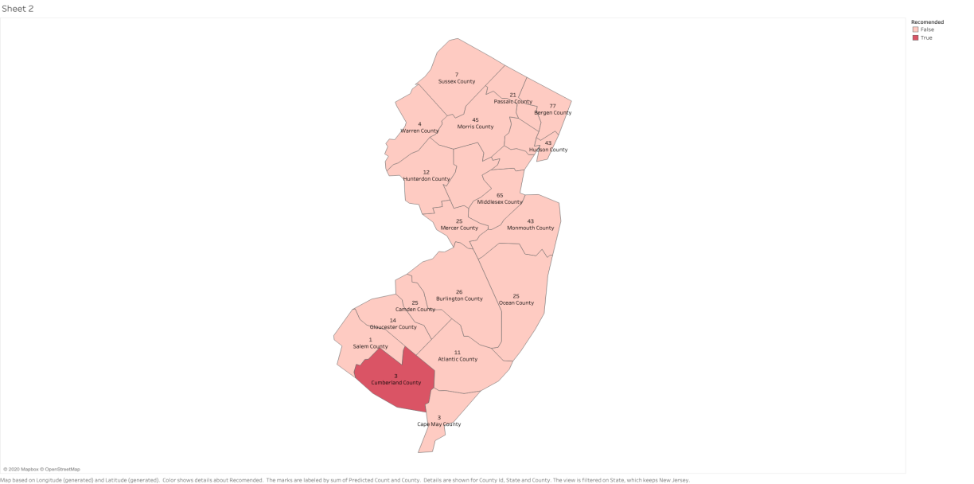
SUGGESTED STARBUCKS IN CUMBERLAND COUNTY (NEW JERSEY) AS PER MULTIPLE LINEAR REGRESSION MODEL (STARBUCKS 2017 DATASET)

Slide 16
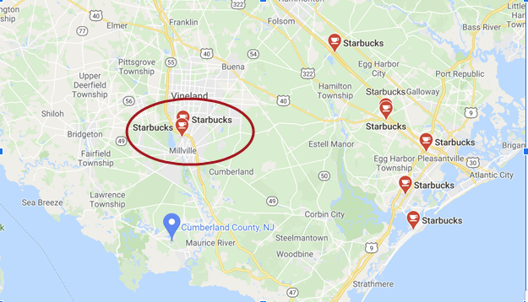
TWO NEWLY OPENED STARBUCKS STORES IN CUMBERLAND COUNTY (PREDICTION AS PER OUR MODEL)
We noticed that Starbucks has opened 2 stores in Cumberland

Slide 17
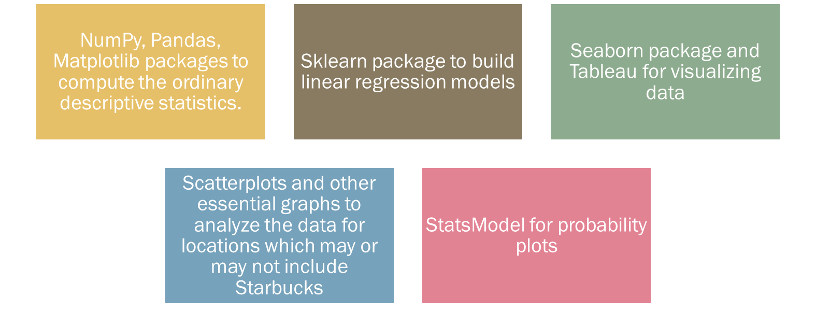
TOOLS USED

Slide 18
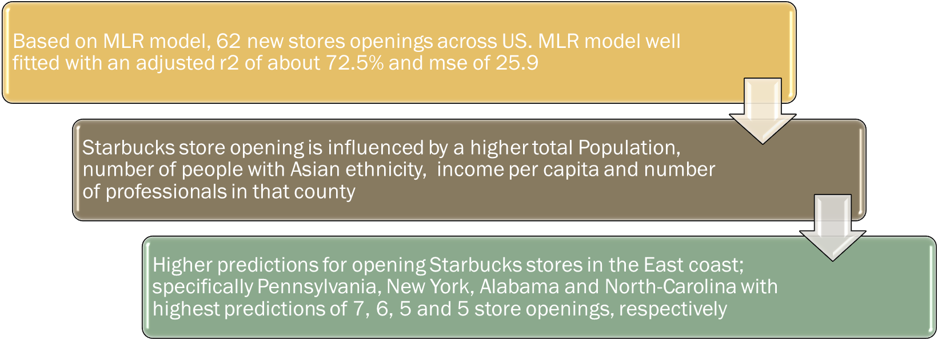
CONCLUSION

Slide 19
Scope of Model
The difference in our prediction and actual Starbucks count in some counties can be partially explained by factors not considered like:
  Market saturation, real estate and labor costs
  Management strategy
  Growth goals of the company

Slide 20
THANKYOU

